Slide 1

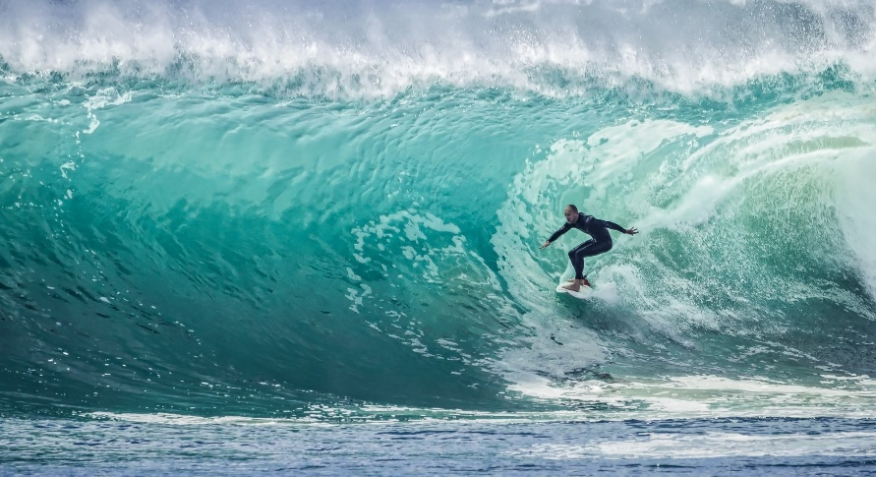
Body Fluids
Prof. Deepthi de Silva
Department of Physiology

Slide 2
At the end of this lecture you should be able to
Describe the body fluid compartments, their composition and measurement
Describe the water balance in an adult human body
Describe osmosis and define osmotic pressure
Define osmolality and osmolarity
Explain isotonicity, hypotonicity, and hypertonicity

Slide 3
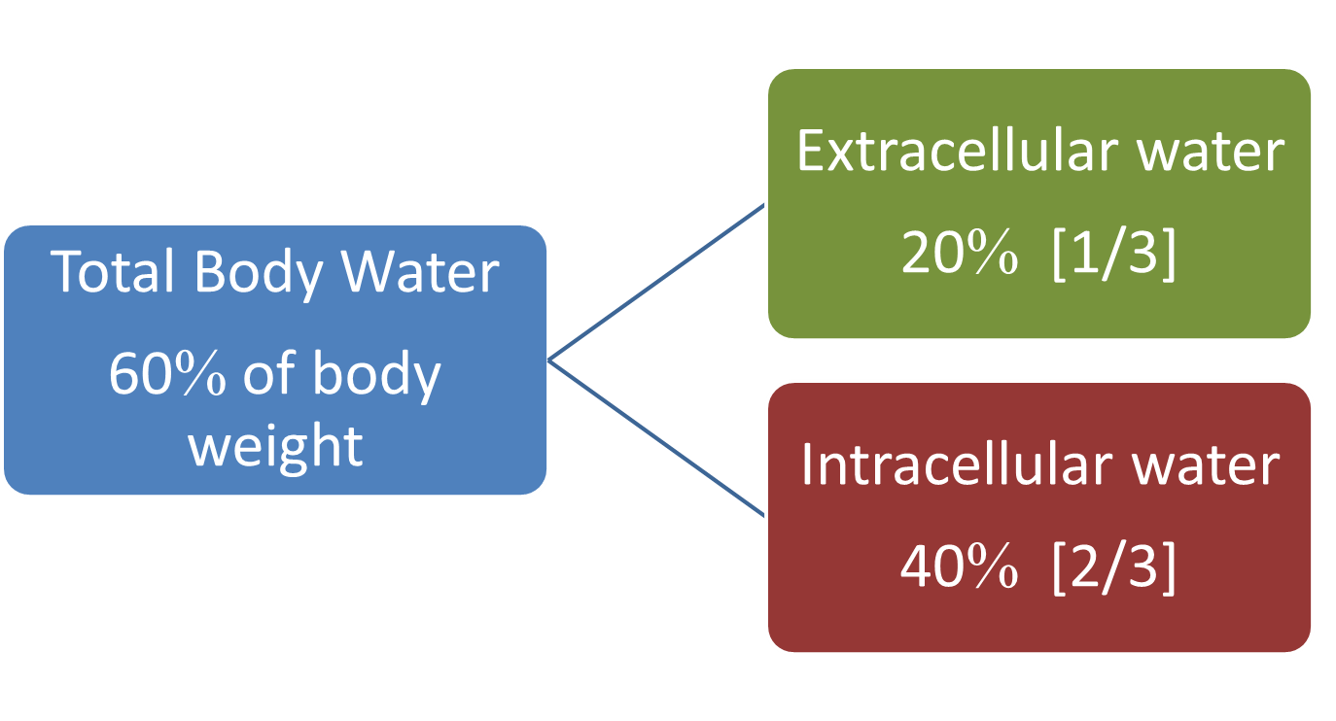
Total Body Water

Slide 4
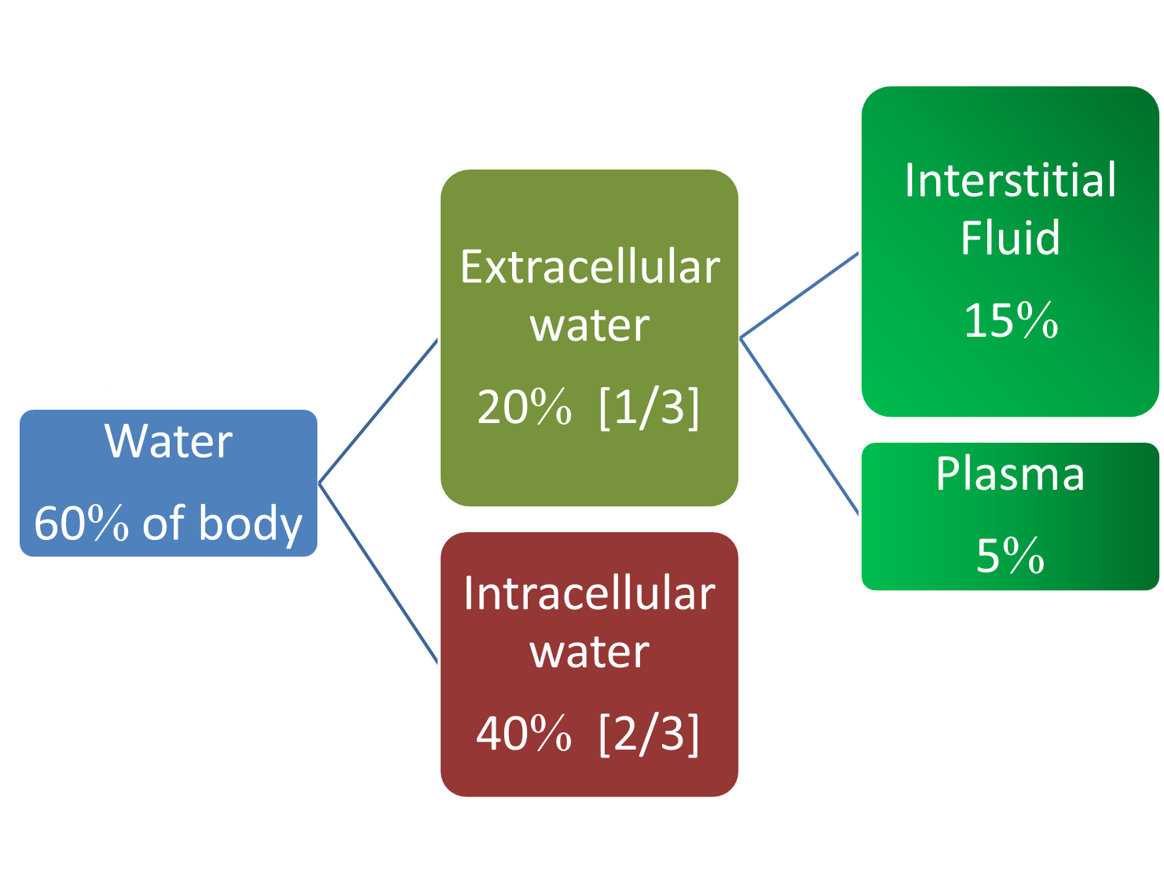

Slide 5
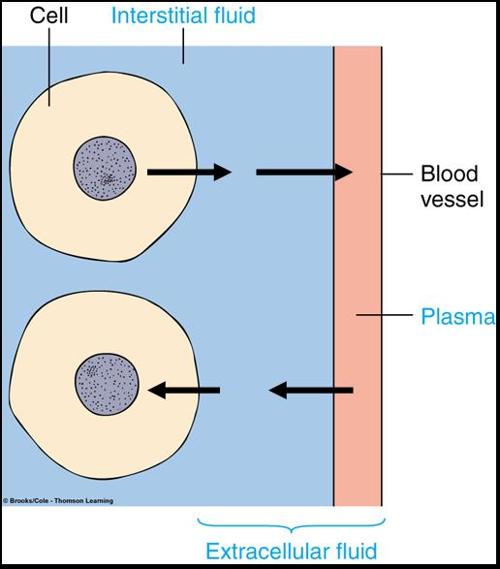

Slide 6
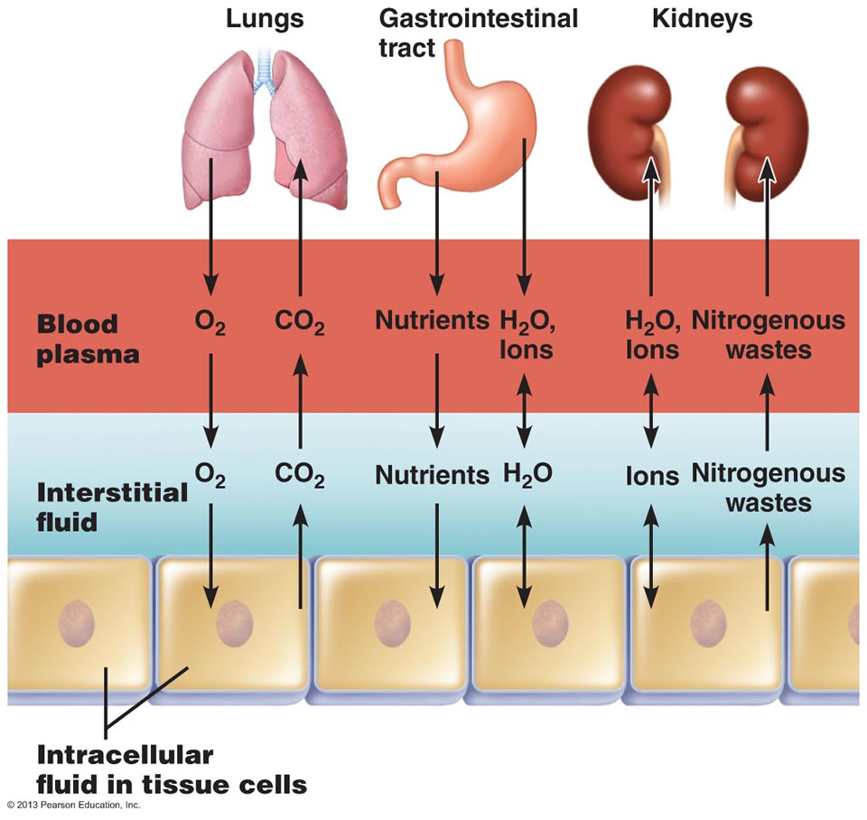

Slide 7
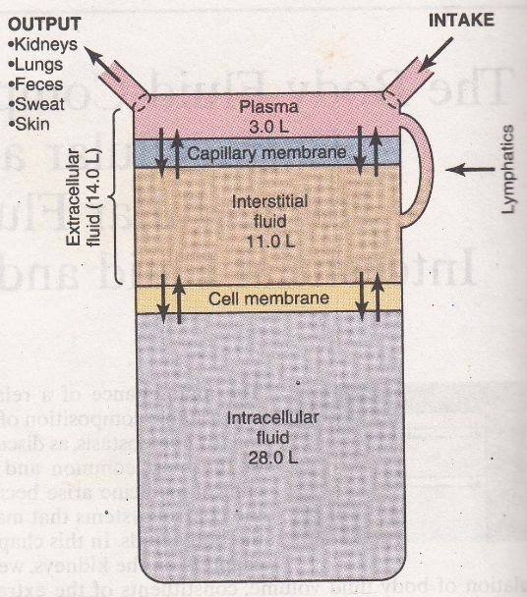

Slide 8
Calculation of volumes of body water in a 70kg man
Total body water
  70 x 60/100 = 42L
Intracellular fluid
  70 x 40/100 = 28 lL
Extracellular fluid
  70 x 20/100 = 14 L
Interstitial water (15%)
  70 x 15/100 = 10.5 L
Plasma (5%)
70 x 5/100 = 3.5 L

Slide 9
Calculate fluid volumes in the various compartments in a 65 kg adult
TBW
ICF
ECF
Plasma
ISF

Slide 10
What would happen if 1L of water is added to the water compartment?
1000ml of body water
Intracellular space Extracellular space
(2/3) (1/3)
667 ml 333 ml
Interstitial space intravascular space
(3/4) (1/4)
250 ml 83 ml

Slide 11
What would happen if 1L of Normal saline (0.9% NaCl) is given intravenously?
Sodium is the main cation in the ECF
NaCl will distribute in the ECF
750 mL (75%) in the interstitial fluid
250 mL (25%) in plasma

Slide 12
What would happen if 1L of 5% dextrose solution is given intravenously?
Dextrose contains glucose- 5% dextrose is isotonic
Once in the body, the cells use up the glucose
Water that is left is distributed in all the body fluid compartments
  2/3 intracellular
  1/3 extracellular (about 330mL)
    About 80ml in plasma and 240mL in interstitium

Slide 13
Measurement of the volumes of body fluid compartments

Slide 14
Body fluid compartments - measurement of volumes
TBW, ECF and Plasma volume can be measured by using dilution principle
Inject a substance that will stay in only one compartment
Calculate the volume of distribution of the injected material
= the volume of fluid in which the test substance is distributed

Slide 15
volume (V) = ^{Quantity (Q)}
^{Concentration (C)}
For substances where it is possible to accurately measure
concentration of substance
amount removed by excretion and metabolism

Slide 16
Principles : substance used must
be non toxic
be evenly distributed in the compartment being measured
not affect the distribution of water in the compartment
not be metabolized or changed or excreted OR extent cannot be determined
be easily measured

Slide 17
Body fluid compartments -
Substances used for measurement of volumes
Total body water by -
Heavy water (D₂O)
Tritium oxide
ECF volume by -
Sodium thiosulphate
Inulin
Mannitol
Plasma volume by -
Evans blue
Radio-labelled serum albumin

Slide 18
True or false?
The intracellular volume is around 50% of body weight in a young adult male
The plasma volume is greater than the interstitial fluid volume
In a 50kg man, the ECF is around 10L
The intracellular volume is measured using heavy water
Infusion of a litre of saline increases the intracellular volume

Slide 19

Refer
What are the body fluid compartments that cannot be directly measured?
How can we determine their volumes?
How to calculate
  Total blood volume and
  Red cell volume

Slide 20
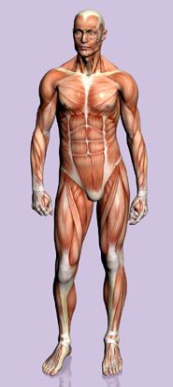
Body water balance
Fluid intake matched by output
Constant body fluid composition and volume

Slide 21
Water intake and loss per day
Fluid intake
Ingested liquids/food
= 2100 ml
Formed by oxidation
= 200ml
Total 2300 ml/day
Fluid loss
Insensible (skin) 350ml
Insensible (lungs) 350 ml
Sweat 100 ml
Faeces 100ml
Urine 1400ml
Total 2300 ml/d

Slide 22
Extracellular fluid (ECF)
1) Intravascular compartment
  Plasma and Lymph
Interstitial fluid (tissue fluid) – bathing the cells
Transcellular fluid
Cerebrospinal fluid (CSF), fluid in joint spaces (synovial fluid), fluid in pleural/pericardial spaces, fluid in peritoneal space, intraocular fluid

Slide 23
What is also in the body water compartments?
Organic substances– glucose, amino acids, proteins, fatty acids, lipids, hormones, enzymes
Inorganic ions – Na⁺, K⁺, Ca^{2+,} Mg^{2+,} Cl⁻, HCO3⁻, PO4²⁻, SO4²⁻

Slide 24
Composition of the ECF
Plasma
Interstitial fluid
Na⁺, Cl⁻, HCO₃⁻
Glucose
Fatty acids
High concentration of plasma proteins eg. Albumin, globulins, fibrinogen
Na⁺, Cl⁻, HCO₃⁻
Glucose
Fatty acids
Low concentration of proteins

Slide 25
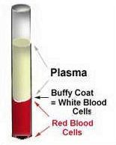
Blood
Average blood volume is 8% of body weight
  5 Litres
Plasma – 55% (ECF)
Blood cells – 45% (ICF) called haematocrit
  0.45 – males
  0.36 - females

Slide 26
Intracellular fluid
ICF has higher levels of
  K⁺, Mg^{2+,} PO₄²⁻, SO₄²⁻
  Protein and ATP
Composition controlled by cell due to selective permeability of cell membrane

Slide 27
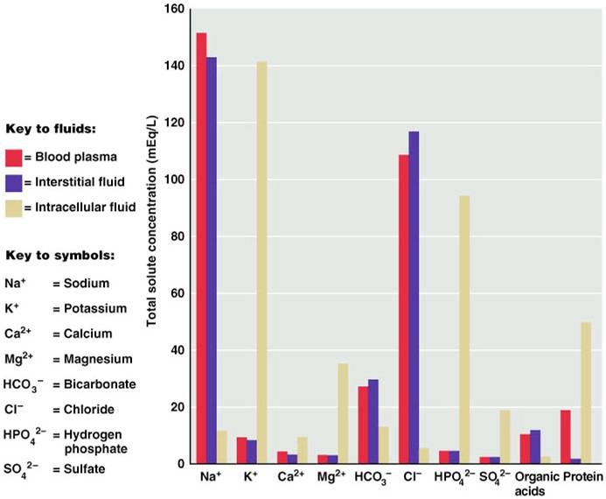

Slide 28
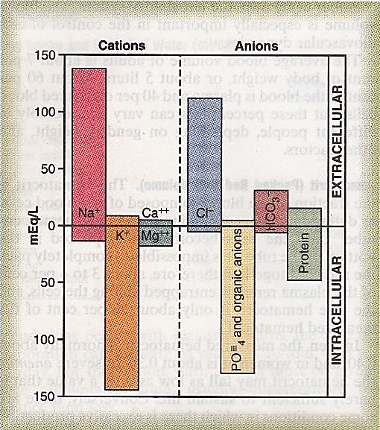
Composition of the ECF and ICF

Slide 29
ECF
ICF
High levels of
Na⁺
Cl⁻
HCO₃⁻
Glucose
Fatty acids
Plasma proteins (plasma)
High levels of
K⁺
Mg²⁺
PO₄²⁻
Proteins
SO₄²⁻
ATP

Slide 30
True or false?
The plasma is around 25% of total body water
There is more protein in the intracellular compartment compared with the extracellular compartment
The interstitial fluid contains less protein that the plasma
The sodium content in the intracellular compartment is higher than the extracellular compartment
The main mechanism of water loss is via the urine

Slide 31
Measuring particles in the body fluid compartments

Slide 32
Moles andOsmoles
  Solute particles
Solution
Solvent (water)
Total number of particles in a solution is measured in moles
1 mole = (6.02x10²³) of solute particles

Slide 33
Osmoles in different solutions
Osmole relates to the number of osmotically active particles in a solution and not to the molar concentration
Solution containing 1 mole of glucose in a litre of water has a concentration of 1 Osm/L

Slide 34
A NaCl molecule dissociates into 2 ions giving 2 particles (Na⁺ + Cl⁻)
Solution containing 1 mole/L NaCl will have an osmolar concentration of 2 Osm/L
A solution containing 1 mole of a molecule that dissociates into 3 ions eg. Na₂SO₄ will contain
3 Osm/L

Slide 35
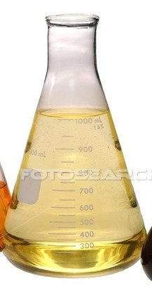
Osmolality vs Osmolarity
Filled up to
1 Litre
Osmolarity- molar concentration of solute particles/L of solution
Osmolality - molar concentration of solute particles/kg of solvent
180g
glucose
+ 1 Litre
180g
glucose

Slide 36
Easier to express body fluid quantities in litres of fluid rather than in kg of water
Therefore body fluids expressed as osmolarity rather than osmolality

Slide 37
Osmolarity of body fluids
80% osmolarity of plasma and interstitial fluid (ECF) is due to Na⁺ and Cl⁻
50% osmolarity of ICF due to K⁺
Plasma osmolarity slightly higher than other fluids due to plasma proteins

Slide 38
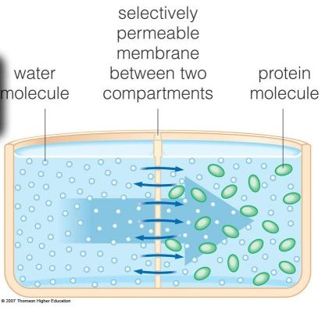

Slide 39
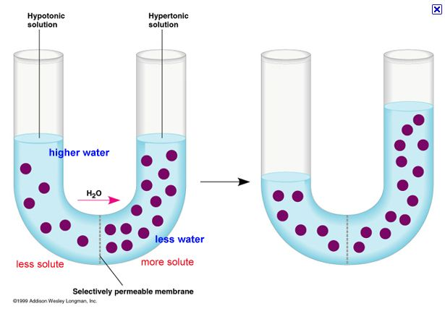
Osmosis
Higher water content
Lower water content
Net diffusion of water
Across a selectively permeable membrane
From a region of high water concentration to one that has a lower water concentration
Less
solute
More
solute
Semipermeable
membrane
H₂O

Slide 40
Osmotic Pressure
Osmosis of water across a selectively permeable membrane can be opposed (stopped) by applying pressure in the opposite direction to that of osmosis
The precise amount of pressure required to prevent osmosis is calle Osmotic Pressure
It is an indirect measure of the water and solute concentration of a solution

Slide 41
Relation between OP and Osmolarity
Osmotic pressure α concentration of osmotically active particles in the solution
I molecule of albumin has same osmotic effect as 1 molecule of glucose
1 molecule of NaCl has 2 osmotically active particles Na⁺ + Cl⁻ (ie twice the osmotic effect of either albumin or glucose)

Slide 42
Osmolarity of Body fluids
Thus OP of a solution is α to its osmolarity (measure of the concentration of its solute particles)
Osmolarity of body fluids is approximately 282 mOsm/L
  This is usually taken as 290 mOsm/L
mmol/L
  Plasma osmolarity calculation
  2[Na ⁺] +[blood Urea nitrogen/2.8] + [Glucose/18]

Slide 43
Cell Membranes
Selectively permeable to most solutes
Highly permeable to water
Water moves from a region of high water concentration to region of low water concentration

Slide 44
Effects of altering tonicity of body fluid compartments

Slide 45
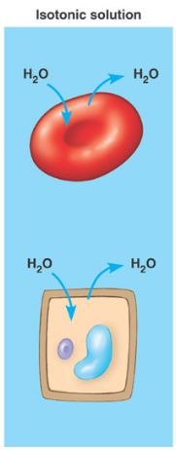
Effect of Isotonic fluids
Equal water concentration in the ICF and ECF
Cell impermeable to solutes
  Solutes cannot enter or leave cell
Isotonic fluid osmolarity is 282 mOsm/L (e.g. 0.9% Nacl; 5% glucose)
In an isotonic solution, there is no change in water movement
Cells will not change their volume

Slide 46
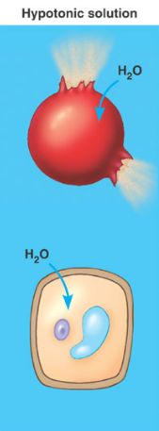
Hypotonic fluid
< 282 mOsm/L
Solution has a low concentration of impermeant solutes
Water concentration outside cell is high
Water moves into cell until both have same osmolarity
  ICF becomes dilute
  ECF becomes concentrated
Cell swells and bursts
E.g. 0.45% NaCl; 2% glucose

Slide 47
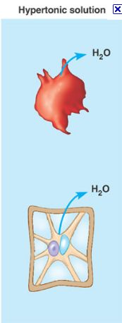
Hypertonic solution
> 282 mOsm/L
Solution has a higher concentration of impermeant solutes
Water concentration outside cell is low
Water moves out of cell into ECF until both compartments have equal concentrations
  ICF gets concentrated
  ECF gets dilute
Cells shrink e.g. 1.8 % NaCl

Slide 48
Changes in fluid balance
Dehydration: loss of fluid from the body
Isotonic contraction (dehydration)
  Loss of water and electrolytes in equal proportions e.g. severe bleeding, burns
 | ECF | No net movement of water | ICF
Volume | Decreased |  | No change
Osmolarity | No change |  | No change

Slide 49
Hypertonic dehydration
Loss of water in excess of electrolytes (especially sodium)
Fluid lost has lower tonicity compared to plasma e.g. severe sweating
 | ECF | Water moves from ICF to ECF | ICF
Volume | Decreased |  | Decreased
Osmolarity | Increased |  | Increased

Slide 50
ECF
Normal : ECF and ICF osmolality identical
No net movement of water
Hypertonic contraction: loss of more water than electrolytes
ECF volume ↓
osmolality ↑
ICF
Water moves from ICF to ECF
ICF volume ↓
ICF osmolality ↑

Slide 51
Hypotonic Dehydration
Loss of more electrolytes than water e.g. Addison disease
 | ECF | Water moves from ECF to ICF | ICF
Volume | Decreased |  | Increased
Osmolarity | Decreased |  | Decreased

Slide 52
Isotonic expansion
Addition of isotonic fluid to ECF
Failure to excrete water and electrolytes eg renal failure, cardiac failure
 | ECF | No net movement of water | ICF
Volume | Increased |  | No change
Osmolarity | No change |  | No change

Slide 53
Hypertonic expansion
Hypertonic fluid given to patient (e.g. mannitol)
 | ECF | Water moves from ICF to ECF | ICF
Volume | Increased |  | Decreased
Osmolarity | Increased |  | Increased

Slide 54
Hypotonic expansion
Addition of water but not electrolytes e.g. drinking large volumes of water
 | ECF | Water moves from ECF to ICF | ICF
Volume | Increased |  | Increased
Osmolarity | Decreased |  | Decreased

Slide 55
Fluid replacement
If the ECF compartment is reduced (i.e. isotonic contraction) fluid replacement has to remain in the ECF
0.9% saline is commonly used for this purpose
1L of saline will be distributed according to the ECF compartment volume: 250mL to plasma
750 mL to interstitial fluid

Slide 56
The use of colloids
Colloid contains proteins
This solution will remain in the circulation (i.e. plasma compartment) and will not leave it to enter the ISF or ICF compartments

Slide 57
True or false?
The body osmolarity is measured in mOsmoles/L
A mole of sodium chloride has twice the osmotic load as glucose
Osmotic pressure is the force required to prevent osmosis across a semipermeable membrane
Potassium is the main osmotically active particle in the plasma
A fall in plasma osmolarity is associated with movement of water inside cells

Slide 58
Filtration across the Capillaries
At the end of this lecture you should be able to
Describe the forces that determine fluid filtration across the capillary
State the magnitude and direction of Starling forces
Define oedema and outline the physiological basis of oedema

Slide 59
Filtration of Fluids in capillaries
Movement of water in and out of tissues occurs in capillaries
Essential to maintain homeostasis
Filtration is the process by which fluid is forced through a barrier because of a difference in pressure on two sides

Slide 60
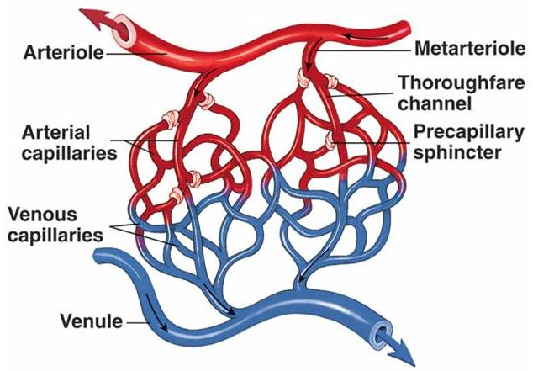
Capillary Microcirculation

Slide 61
Structure of Microcirculation
Arterioles
Metarterioles
Precapillary sphincters:
regulate blood flowing into arterial capillaries
Venular capillaries
Venules and veins

Slide 62
Fluid movement across a capillary ‘Capillary dynamics’
2 main factors determine fluid movement across capillary wall
Hydrostatic pressure (BP) – tends to push fluid out of the blood vessel
Osmotic pressure – tends to pull fluid back into blood vessels mainly due to the presence of plasma proteins (albumin)

Slide 63
Hydrostatic pressure = Blood pressure
Hydrostatic pressure (blood pressure) is the pressure exerted by blood on the capillary walls
HP tends to force fluid and dissolved substances through the capillary pores into the interstitial spaces

Slide 64
Osmosis across a cell membrane
Osmosis will move water from a more dilute to a more concentrated solution across the cell membrane
    Osmotic pressure depends on the number of osmotically active, non diffusible particles in the solutions separated by the membrane
The main substance responsible for the OP between blood and tissue fluid are the plasma proteins especially albumin

Slide 65
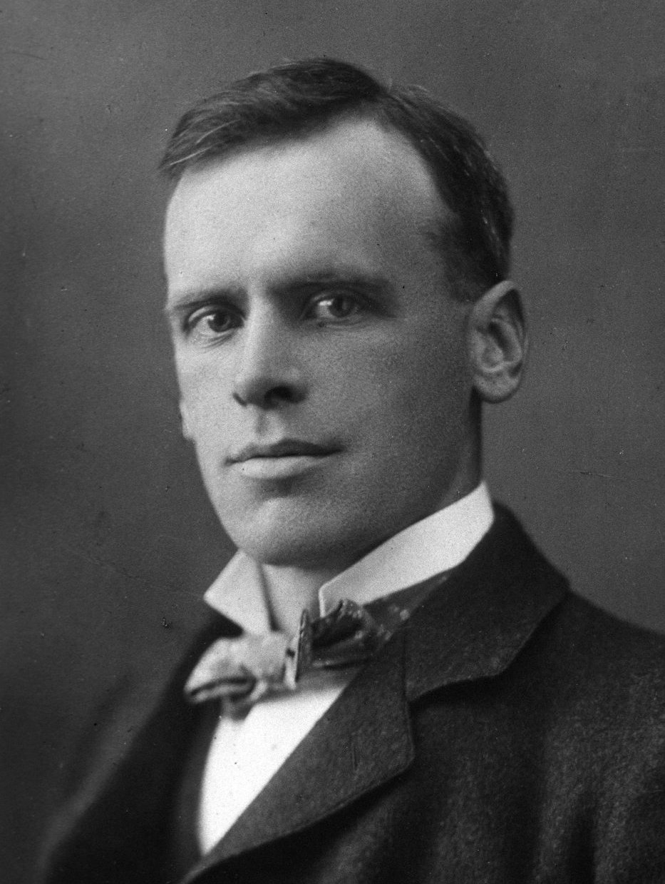
Fluid filtration in capillaries
Forces involved described by an English Physiologist Ernest Starling
Ernest Starling
1866 to 1927

Slide 66
Starling forces
Capillary HP (P_{c}) – forces fluid out through the capillary membrane
Interstitial fluid pressure (P_{if}) – tends to force fluid from interstitial spaces across capillary membrane
Capillary plasma colloid OP (π_{p}) – tends to cause osmosis of fluid inward through capillary membrane
Interstitial fluid colloid OP (π_{if}) – tends to cause osmosis of fluid outward through capillary membrane - negligible

Slide 67
Filtration
Filtration = k (P_{c} – P_{if} ) – (π_{p} – π_{if} )
= k x Net filtration pressure
k = capillary filtration coefficient
Permeability of capillary wall
(Number and size of pores in each capillary)
Surface area for filtration
(Number of capillaries in use)

Slide 68
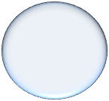
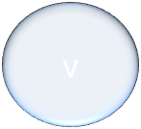
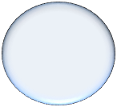


Starling forces
  Arterial end venous end
HP (P_{c})
COP (π _{p})
P_{if}
π_{if}
v
v

Slide 69
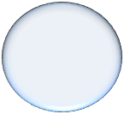

Starling forces
  Arterial end venous end
P_{c}=37 mm Hg
(π _{p}) =25 mm Hg
P_{c}=17 mm Hg
Πif = 0 mm Hg
P_{if} = 1 mm Hg
v
v

Slide 70
Forces acting at Arteriolar end:
Favours formation of tissue fluid
Outwards
Capillary HP (P_{c}) = 37 mm Hg
Interstitial fluid COP
(π _{if} ) = 0 mm Hg
37 mm Hg outwards
Inwards
Capillary plasma COP (π_{p} ) = 25 mm Hg
Interstitial fluid pressure (P_{if}) = 1 mm Hg
26mmHg inwards
Summation of forces = 37 – 26 = 11 mm Hg
Net outward force = 11 mm Hg

Slide 71
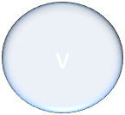
Starling forces favouring fluid filtration at capillary
  Arterial end venous end
P_{c}=37 mm Hg
(π _{p}) =25 mm Hg
P_{c}=17 mm Hg
Πif = 0 mm Hg
P_{if} = 1 mm Hg
v
v
Net force at arterial end 37 – 26 = 11mm Hg outwards
Tissue fluid formation

Slide 72
Forces acting at venular end
Outwards
Capillary HP (P_{c})
= 17 mm Hg
Interstitial fluid COP (π _{if}) = 0 mm Hg
Total 17 mm Hg outwards
Inwards
Capillary plasma COP (π_{p} ) = 25 mm Hg
Interstitial fluid pressure (P_{if}) = 1 mm Hg
Total of 26mmHg inwards
Summation of forces = 26 - 17 = 9 mm Hg
Net inward force = 9 mm Hg
Tissue fluid reabsorption

Slide 73
Starling forces favouring fluid filtration at capillary
  Arterial end venous end
P_{c}=37 mm Hg
(π _{p}) =25 mm Hg
P_{c}=17 mm Hg
Πif = 0 mm Hg
P_{if} = 1 mm Hg
v
Net force at venous end (26 – 17 mm Hg) = 9 mmHg inwards
Tissue fluid reabsorption
v

Slide 74
Starling forces favouring fluid filtration at capillary
  Arterial end venous end
At arterial end, net force is 11 mm Hg outwards
Tissue fluid formation
At venous end, net force
is 9 mm Hg inwards
Tissue fluid reabsorption
v
v

Slide 75
Reabsorption pressure is less than filtration pressure
  Venous capillaries are more numerous and more permeable than arterial capillaries
  Less reabsorption pressure is required to cause inward movement of fluid
90% of fluid filtered at arterial end is reabsorbed at venous end
10 % fluid enters lymphatics and returned to circulation

Slide 76
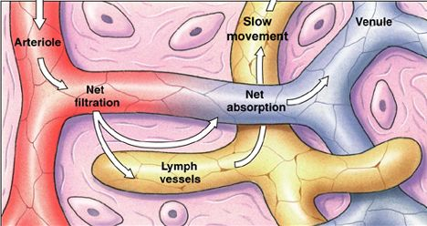
Lymphatic System
System of vessels which returns to small amounts of excess protein and fluid from interstitial spaces to the circulation

Slide 77
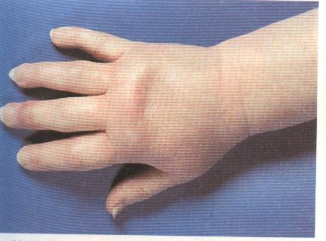
Oedema
Accumulation of excess fluid in the interstitium
Caused by alteration of Starling forces

Slide 78
Oedema
Accumulation of tissue fluid in interstitial spaces, in abnormal amounts, once the capacity of the lymphatics are exceeded
Due to alterations of Starling forces

Slide 79
Oedema due to increased capillary hydrostatic pressure
Increased pressure at the venous end of capillaries
Causes of ↑ venous pressure -
1. ventricular failure
- RVF → systemic oedema
- LVF → pulmonary oedema
2. Venous obstruction e.g venous thrombosis

Slide 80
Oedema due to ↓colloid osmotic pr (πc )
Hypoalbuminaemia -
Lack of raw materials (amino acids) due to protein malnutrition, maldigestion or malabsorption
Impaired synthesis - Chronic Liver disease or Liver failure (e.g. Cirrhosis of the liver)
Increased losses from -
Kidneys e.g. Nephrotic syndrome
Gastrointestinal tract
Skin e.g. severe burns

Slide 81
Increased capillary permeability as a cause of oedema
Most commonly causes local oedema eg.
insect bites following release of substances like histamine
some allergic conditions - angioneurotic oedema
Capillary damage – local swelling of a bruise

Slide 82
Lymphatic obstruction as a cause of oedema
Lymphoedema occurs :
in lymphatic obstruction e.g Filariasis
where lymph nodes have been removed eg. when treating cancers

Slide 83
Mechanisms of oedema formation -
↑ capillary hydrostatic pr. (P_{c})
↓ Colloid osmotic pr (π_{c} ) due to decreased plasma proteins especially albumin
↑ Capillary permeability
Lymphatic obstruction

Slide 84
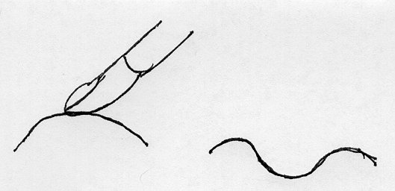
Oedema - signs
↑ in body weight , first sign
“Pitting oedema” - a pit is formed when the swollen area is pressed with a finger
Lymph oedema is non-pitting
Press down with finger
Pit

Slide 85
Can you
describe the distribution of water in the different body fluid compartments?
Explain the difference in the composition between in intra and extra cellular compartments?
Explain the factors that determine osmosis and define the osmotic pressure?
State the normal osmotic pressure and explain the effect on cells of exposing them to isotonic, hypotonic and hypertonic fluids?
Describe Starling forces that determine fluid filtration across capillaries?

